Slide 1
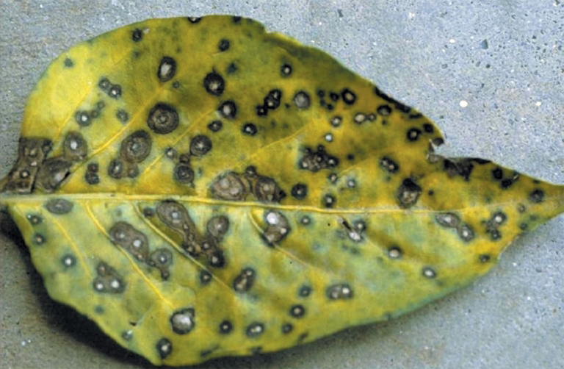
Fruit Leaves Disease Detection

Slide 2
Machine learning SEC-C
Md Shazzad Hossain Jiku 011221073
Rudro Kumar Bandhapadhay 011221118
Nusrat Jahan 011221269
Mridul Kanti Paul 011221265

Slide 3
Index
Chapter | Chapter Name | page No
1 | Title | 4
2 | Motivation | 4
3 | Application | 5
4 | Expected Outcome | 6
5 | Proposed Method | 7
6 | References | 8-12

Slide 4
Chapter 1: Title Automated Leaf Disease Detection in Fruit Crops using Machine Learning and Image Processing Techniques.
Chapter 2: Motivation
Agriculture is one of the primary sources of food and economy in most countries, including Bangladesh. A major challenge in fruit farming is the occurrence of plant leaf diseases, which reduces both the quality and quantity of the produce. Traditionally, farmers identify diseases manually, which is time-consuming, inaccurate, and depends on expert knowledge. Automated disease detection using modern technologies such as image processing, machine learning, and deep learning can provide early detection, reduce crop losses, minimize pesticide misuse, and ensure food security.

Slide 5
Chapter 3: Application
1.Early detection of fruit leaf diseases (e.g., apple scab, grape black rot, mango leaf spot).
2.Smart agriculture systems (IoT-based monitoring and alert systems).
3.Decision support for farmers (disease identification + treatment suggestion).
4.Integration in mobile apps for on-field real-time disease recognition.
5.Improved yield prediction by controlling diseases at an early stage.

Slide 6
Chapter 4: Expected Outcome
1.A high-accuracy automated model for identifying fruit leaf diseases from images.
2.A dataset of diseased and healthy leaves for research purposes.
3.A comparative study of machine learning vs. deep learning techniques.
4.A potential mobile or web-based prototype for farmers to use in real-world scenarios.

Slide 7
Chapter 5: Proposed Method
Data Collection: Gather fruit leaf images (healthy and diseased) from publicly available datasets (Plant Village, Kaggle, etc.) and real-field images.
Pre processing: Apply image enhancement, noise removal, and normalization to improve quality.
Segmentation: Extract the diseased portion of the leaf using methods like k-means clustering, thresholding, or edge detection.
Feature Extraction: Identify color, texture, and shape features.
Classification Models:
Machine Learning: SVM, Random Forest, KNN.
Deep Learning: CNN, ResNet, EfficientNet.
Performance Evaluation: Measure accuracy, precision, recall, F1-score.
Deployment (Optional): Build a simple mobile/web app for real-time detection.

Slide 8
Chapter 6: References
1.Title:
Using Deep Learning for Image-Based Plant Disease Detection
Journal: Frontiers in Plant Science (2016)
DOI: 10.3389/fpls.2016.01419
License: Open Access under CC
2. Title:
Deep Neural Networks Based Recognition of Plant Diseases by Leaf Image Classification
Journal: Computational Intelligence and Neuroscience (2016), Article ID: 3289801
DOI: 10.1155/2016/3289801
License: CC BY (Creative Commons Attribution

Slide 9
Chapter 6: References
3.Title:
Deep learning models for plant disease detection and diagnosis
Journal: Computers and Electronics in Agriculture (2018)
DOI: (Finding DOI missing in our search; you may need to look it up in Scopus or journal website)
License: (Likely standard publisher terms; open-access status not confirmed)
4.Title:
Deep Learning for Tomato Diseases: Classification and Symptoms Visualization
Journal: Applied Artificial Intelligence (2017)
DOI: (Not found in our quick search; you may need publisher lookup)
License: (Unclear; likely standard closed unless stated)

Slide 10
Chapter 6: References
5.Title:
Detection of plant leaf diseases using image segmentation and soft computing techniques
Journal: Information Processing in Agriculture (2017)
DOI: 10.1016/j.inpa.2016.10.005
License: (Not explicitly stated; likely standard publisher policy)
6.Title:
Leaf image based cucumber disease recognition using sparse representation classification
Journal: Computers and Electronics in Agriculture (2017)
DOI: (Not found in our quick search; recommend checking journal site)
License: (Unclear; depends on journal access policy)

Slide 11
Chapter 6: References
7.Title:
Deep learning models for plant disease detection and diagnosis
Journal: Computers and Electronics in Agriculture (2018), Volume 145, Pages 311–318
DOI: 10.1016/j.compag.2018.01.009
License: © 2018 Elsevier B.V.; All rights reserved
8. Title:
Deep learning and computer vision in plant disease detection: a comprehensive review of
Journal: Artificial Intelligence Review (2025)
DOI: 10.1007/s10462-024-11100-x
License: © The Author(s) 2025 (Springer Nature); typically Open Access, check journal details

Slide 12
Chapter 6: References
9.Title:
Plant Disease Detection and Classification by Deep Learning
Journal: Plants (MDPI)
DOI: (Not directly available in preview; MDPI usually provides DOIs of format 10.3390/plants <year><article number>) – needs lookup
License: MDPI articles are generally Open Access (CC BY)
10.Title:
Explainable vision transformer enabled convolutional neural network for plant disease identification: PlantXViT
Journal: (Preprint, likely arXiv – not peer-reviewed)
DOI: None (arXiv ID: 2207.07919) – arXiv papers don’t use DOIs by default
License: Depends on arXiv submission; not necessarily CC BY – often arXiv default license, check specific submission metadata.

